Slide 1
How to clean SIM and SD card contacts and apply contact grease
Using correct tools and methods

Slide 2
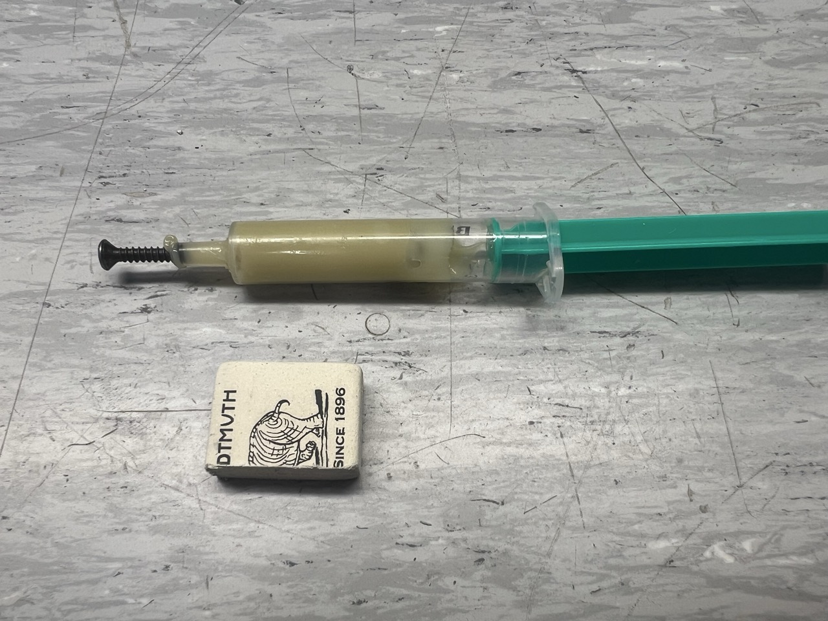
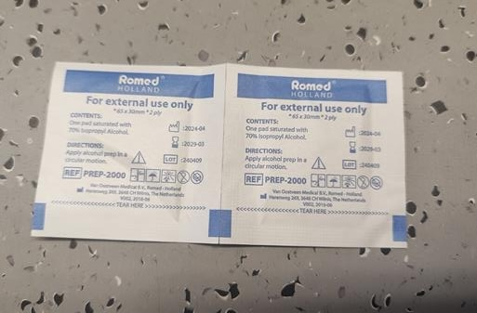
Required tools and materials
Contact sealant paste / grease – recommended PN 5630105950
Pencil (school rubber) eraser – regular type
Cleaning Q tip or small brush
Alcohol wipe for maintenance to clean old grease / paste / oil

Slide 3
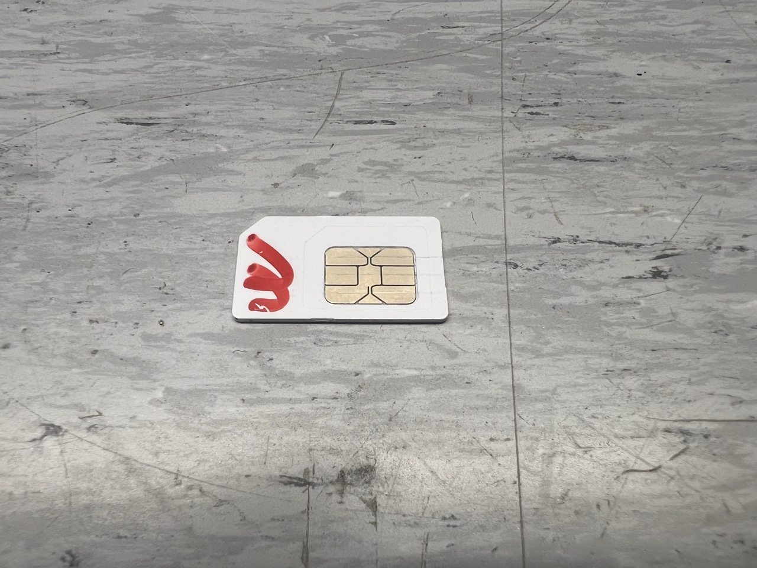
Remove SIM / SD card from device
Turn off device (charger) before removing SIM or SD card!
Remove SIM or SD card from the charger
Clean SIM / SD card even if contacts looks clean!
If there was paste or grease or oil residue on card wipe and clean it off completely with alcohol wipe!

Slide 4
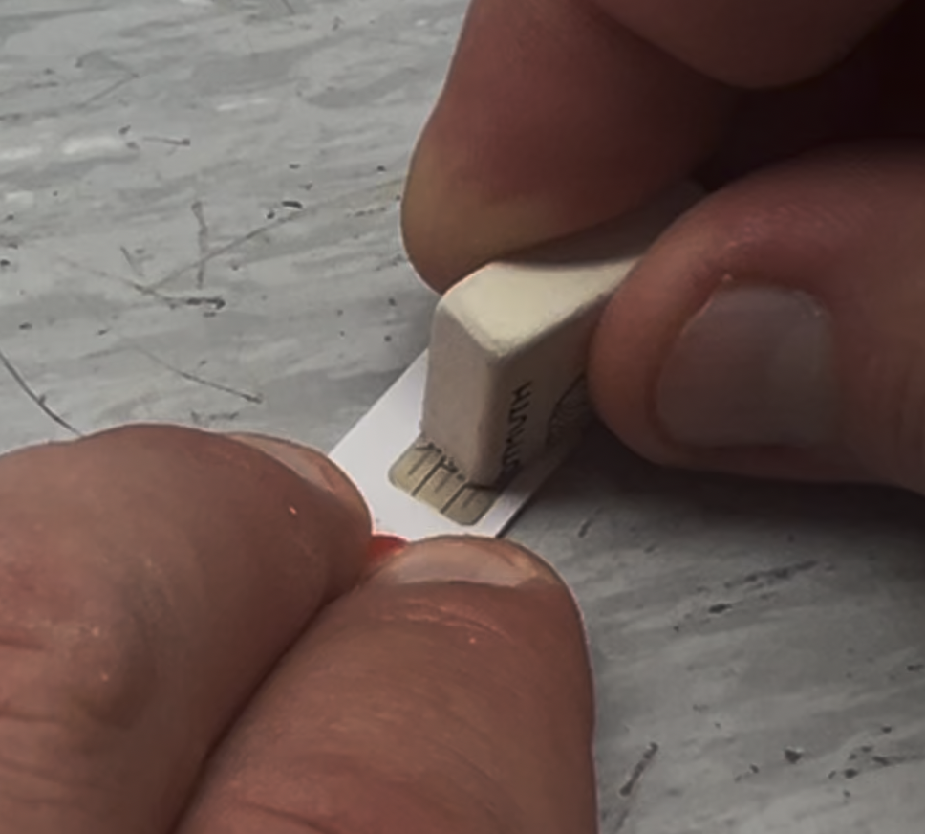
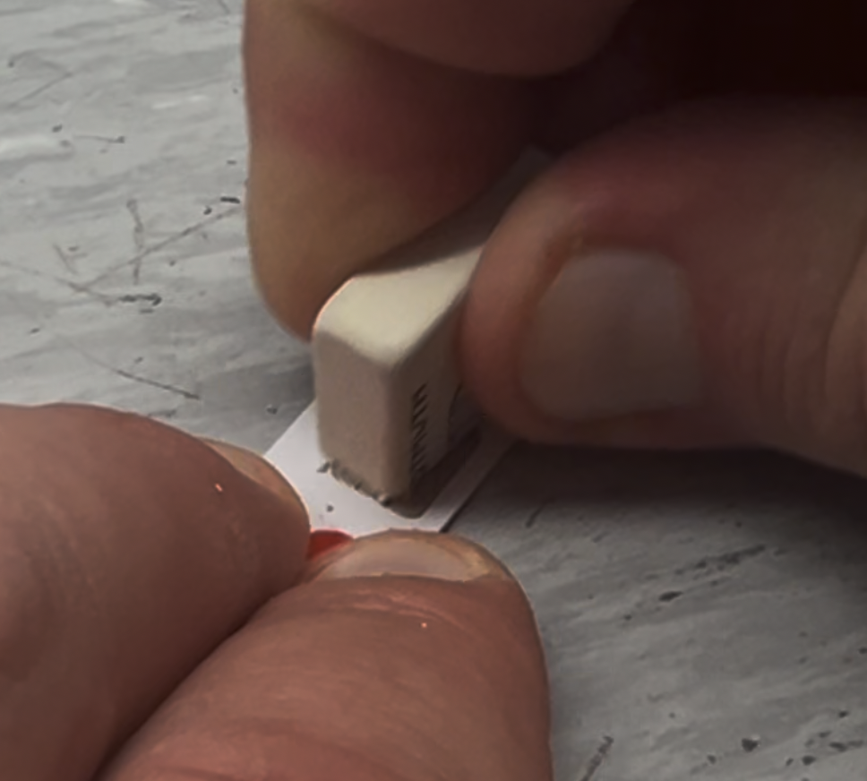
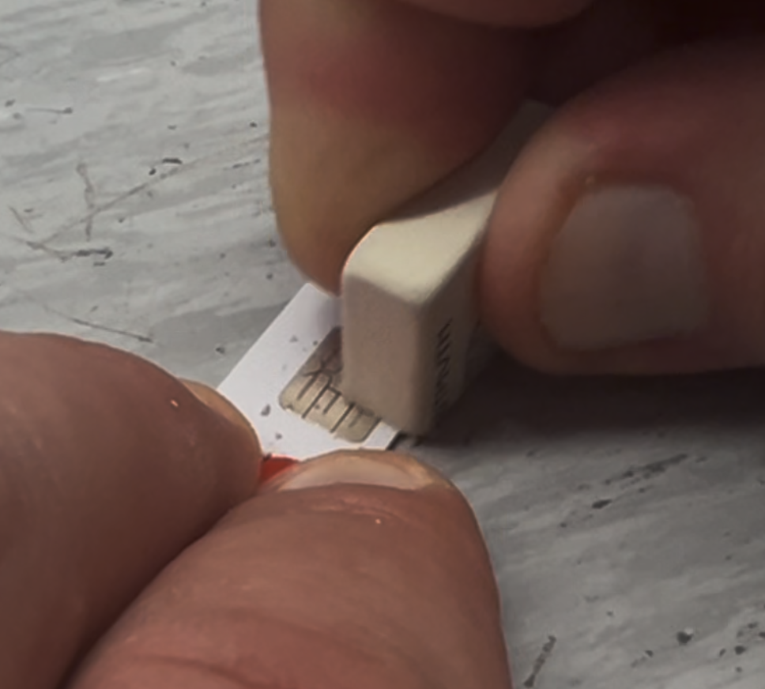
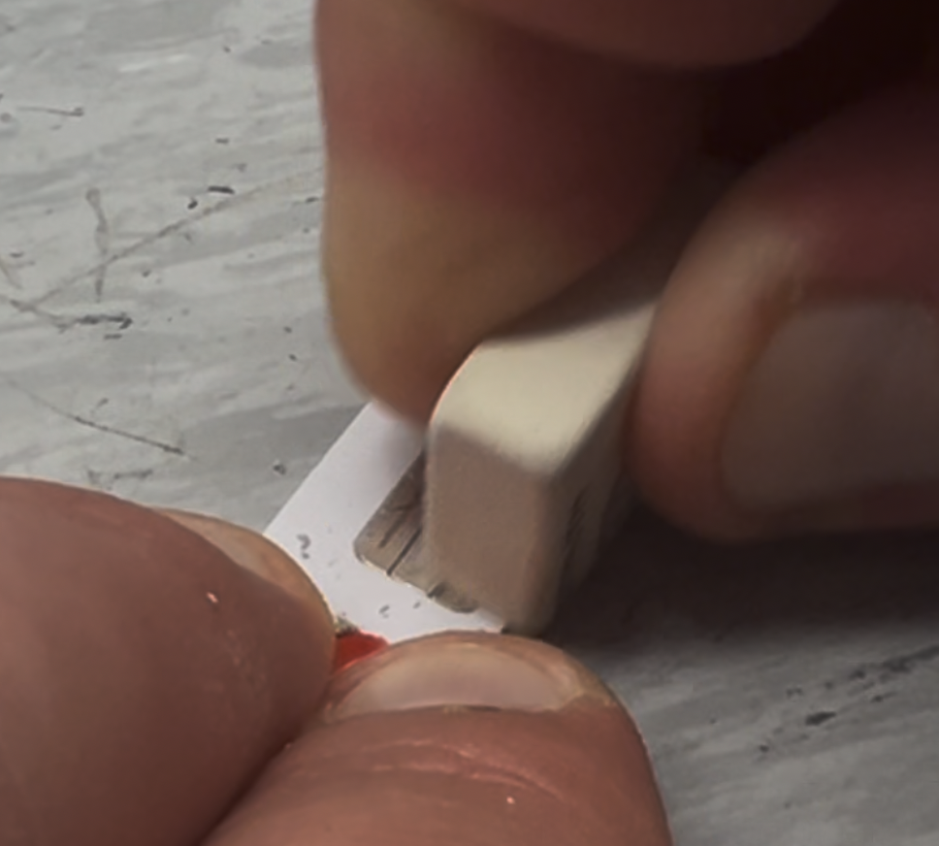
Clean SIM / SD card
Use pencil eraser (rubber) to clean contacts mechanically
Use edge of the eraser and apply pressure on the card
Move rubber in circular motion or up/down and left/right to clean contacts.
Continue until contacts are almost mirror like shine.

Slide 5
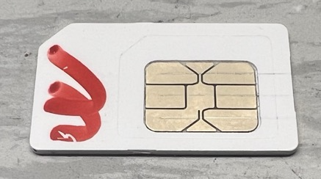
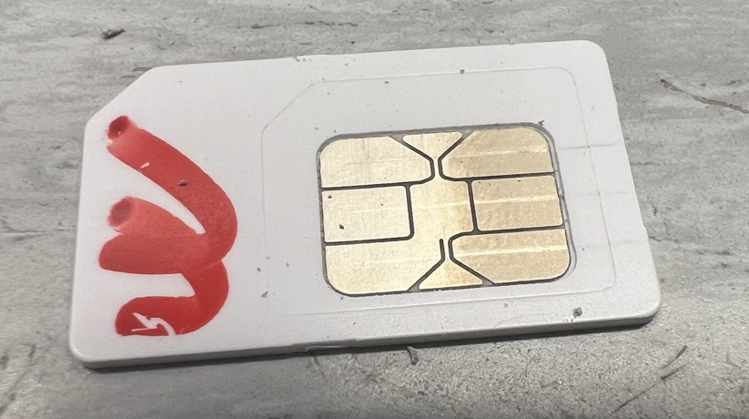
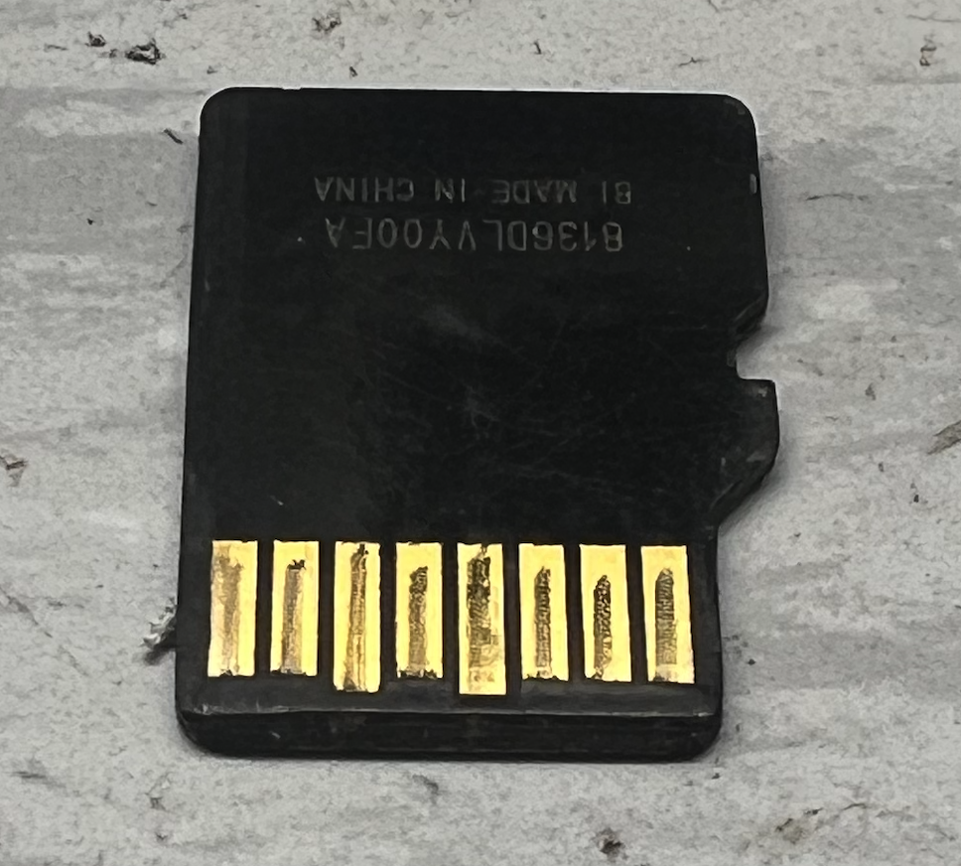
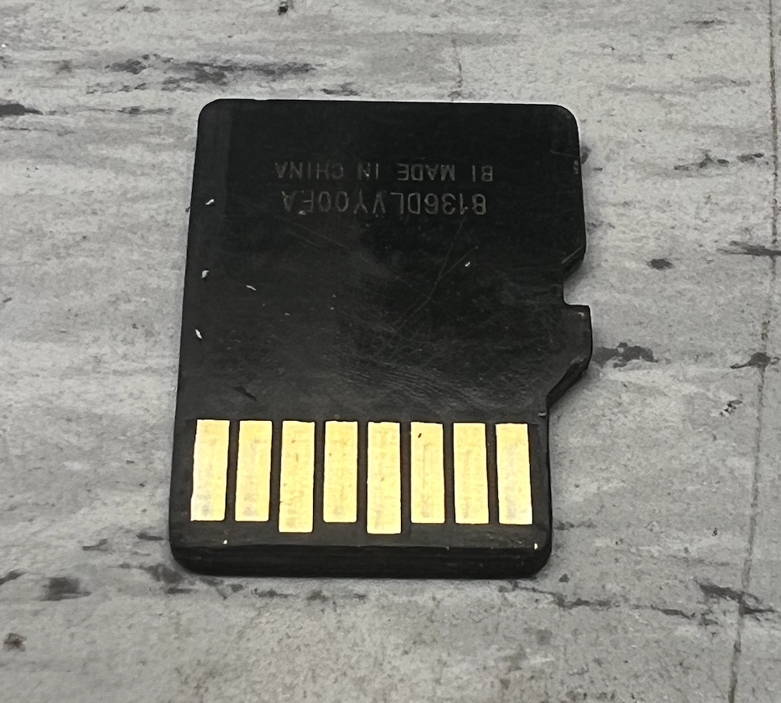
Clean SIM / SD card
See example below how contacts look before and after cleaning
After cleaning do not touch the contacts again with fingers!
Wipe off eraser residue with alcohol wipe, Q tip or brush.
Before
After cleaning

Slide 6
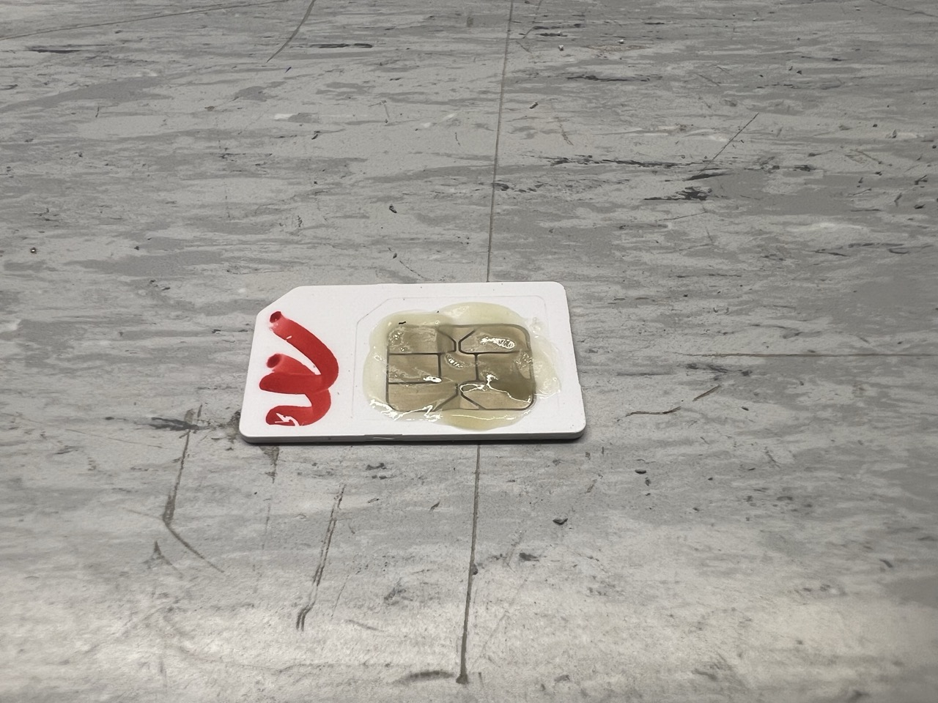
Apply contact paste / grease
After mechanical cleaning do not touch or drop some liquid on the card!
Don’t forget to wipe off any residue from the eraser.
Apply contact paste on the contacts of the card – see example below.

Slide 7
Cleaning finished
Once contact paste is applied return SIM / SD card back to the device.
Turn on device.

Slide 8
Smarter. Greener. Together.

