Slide 1
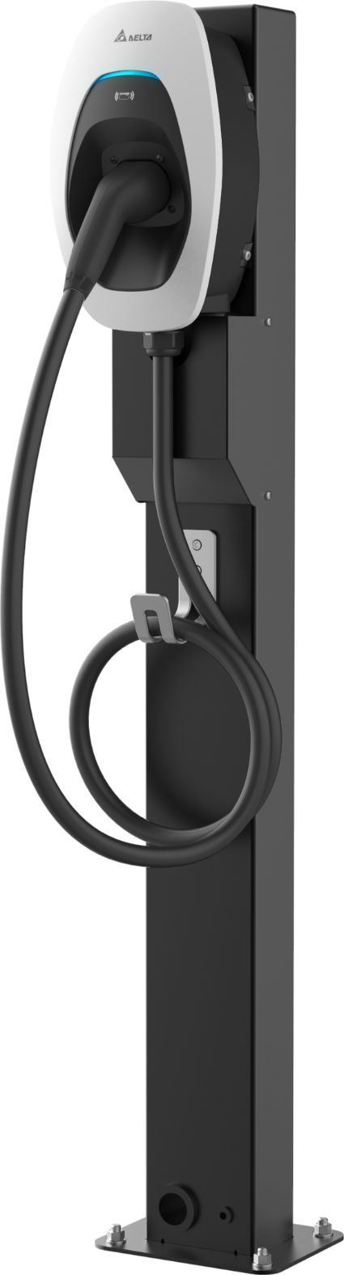
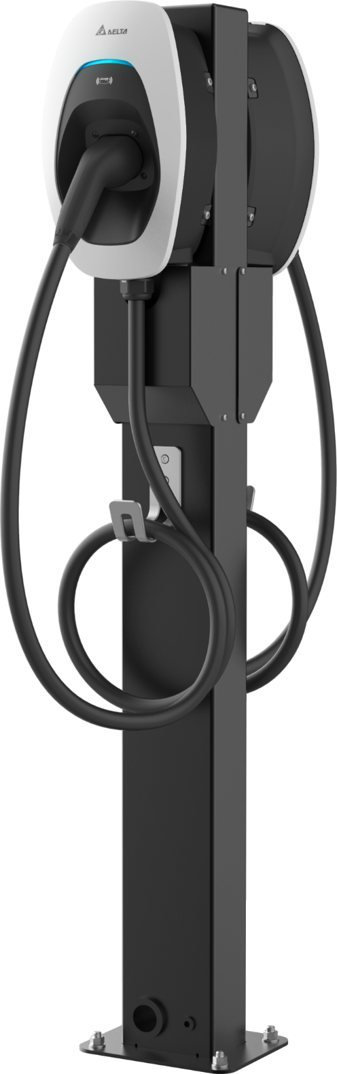
AC MAX Pedestal
Training
Stefan Walter
February 2023

Slide 2
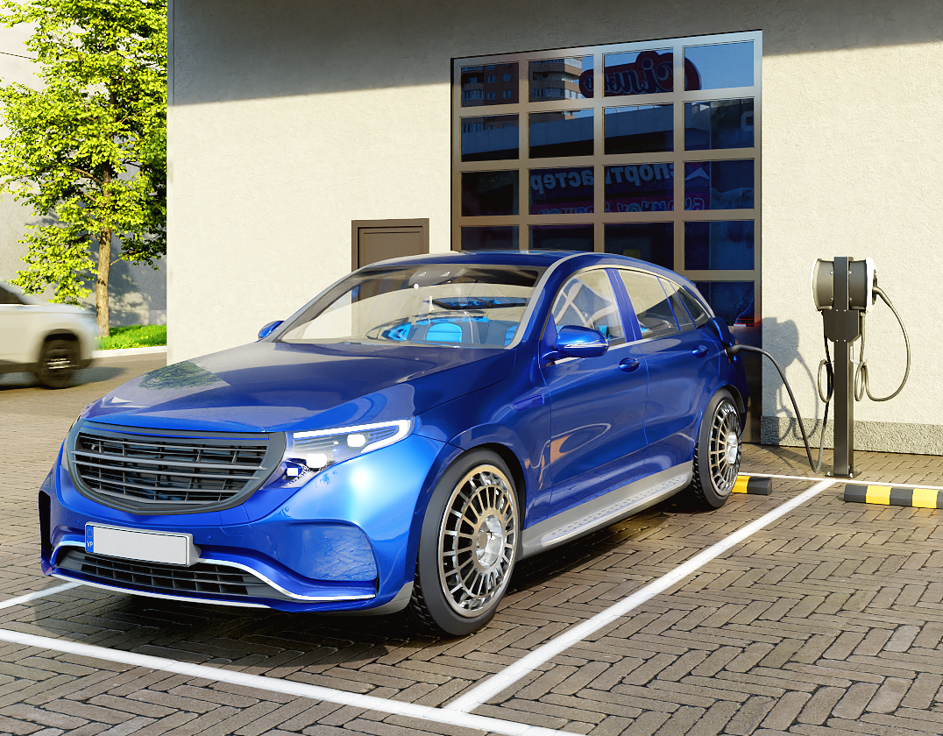
AC MAX Pedestal
Product Introduction
Highlights
Mounting pole for parking space installations
Galvanized steel
Black grey powder coated surface for a robust and appealing design
Single-sided and double-sided model available
Easy to install

Slide 3
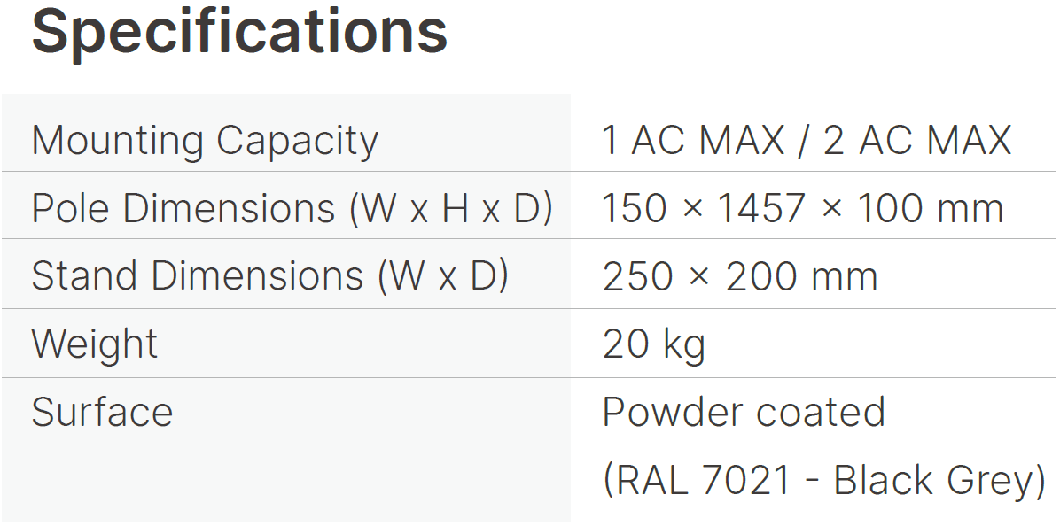
AC MAX Pedestal
Product Introduction

Slide 4
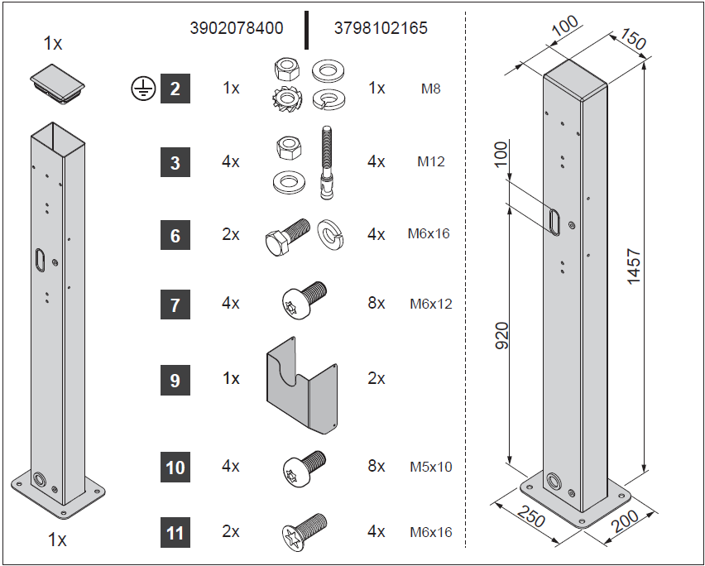

AC MAX Pedestal
Scope of Delivery
Theft prevention screws

Slide 5
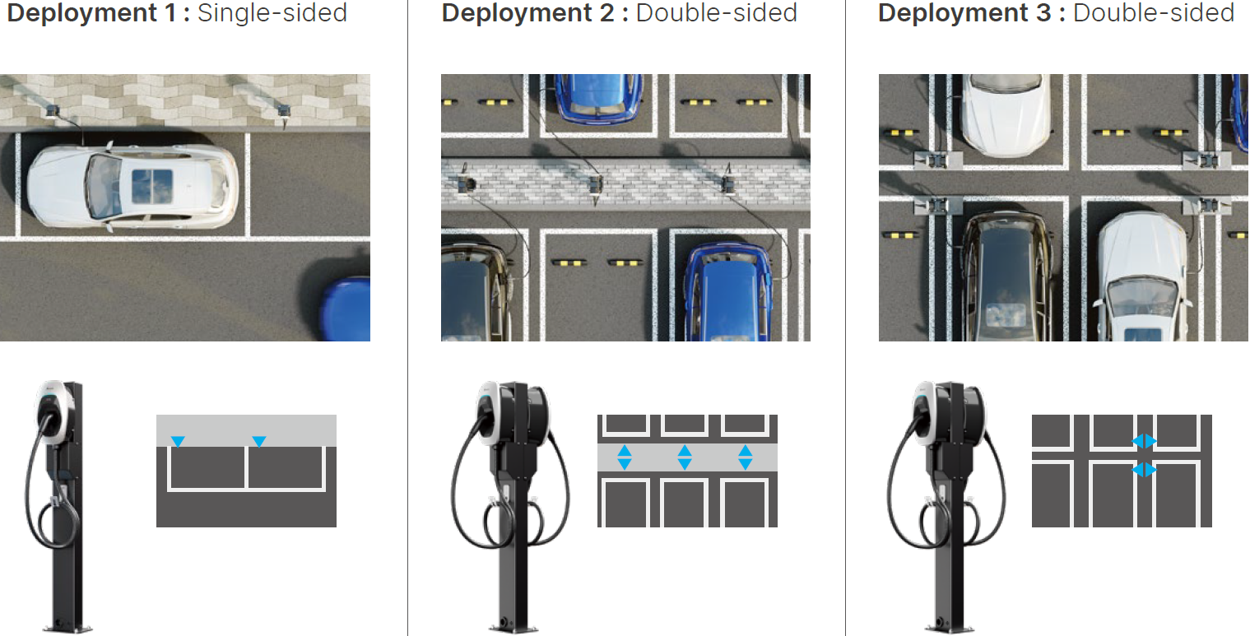
AC MAX Pedestal
Parking Space Arrangements

Slide 6
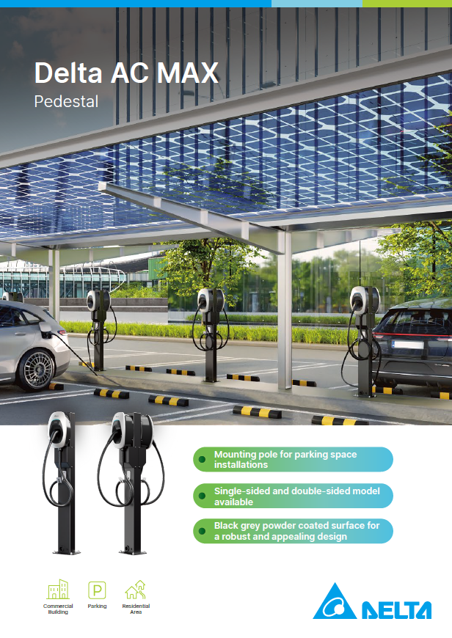
AC MAX Pedestal
Marketing Material
Product Leaflet
Others
Images / Photos
Exhibition model

Slide 7
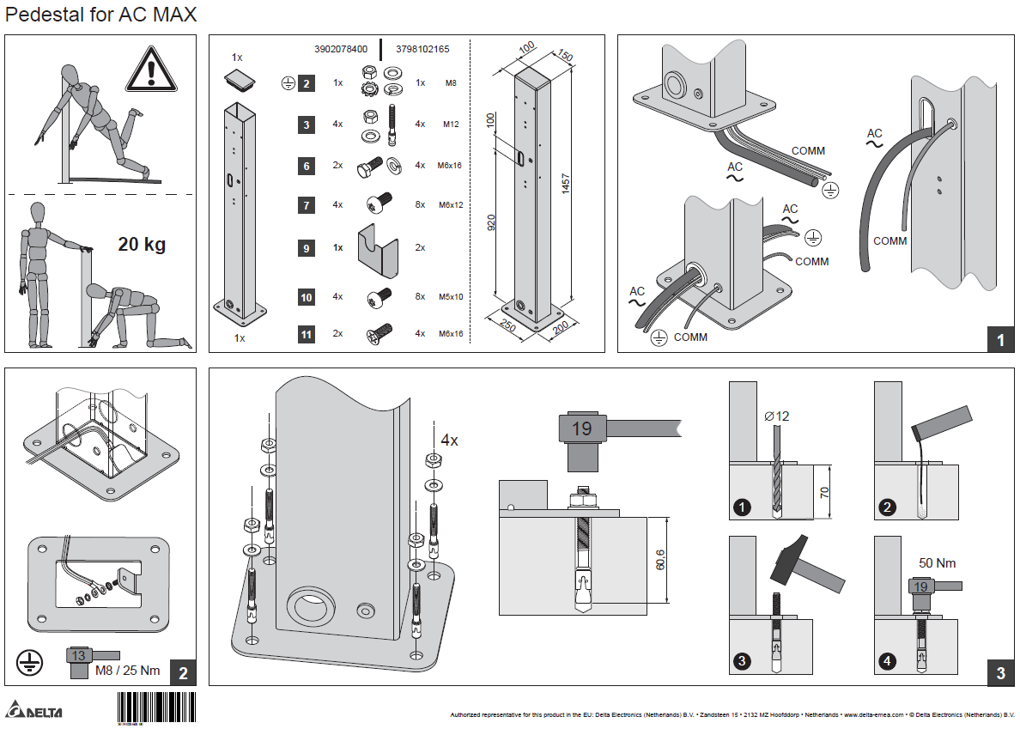
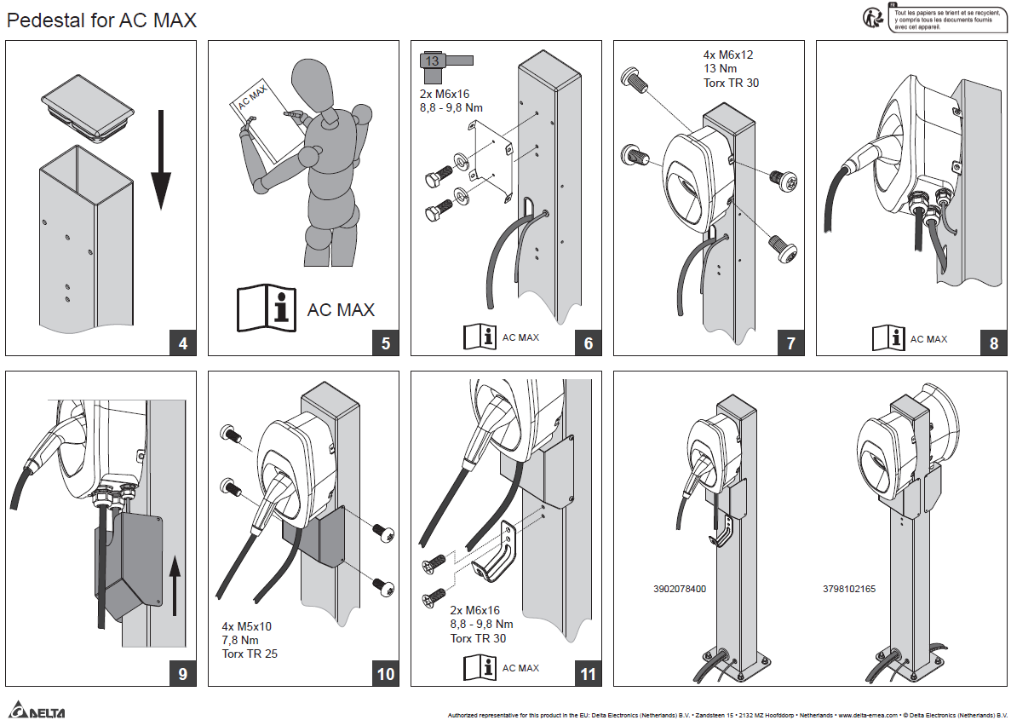
AC MAX Pedestal
Installation Manual

Slide 8
AC MAX Pedestal
Route to Market
Option 1: Channel Business
Option 2: Project Business
Product offered DDP
Freight costs to be included in the sales price
Order with installation location as “ship-to” address
Advantage: Direct delivery to the installation location
Channel partners normally do not take pedestals to their warehouses.
Product offered EXW
Freight costs added extra
Ship to project or partner address
Advantage: Lower shipment costs

Slide 9


